Slide 1
Module 4:INTRODUCTION TO PERIPHERAL INTERFACING - I

Slide 2
PERIPHERAL INTERFACING
Microprocessor based system design involves interfacing of the processor with one or more peripheral devices for the purpose of communication with various input and output devices connected to it.
During the early days of the microprocessor revolution, these techniques required complex hardware consisting of Medium scale integration devices makes the design highly complex and time consuming.
INTEL have developed a large number of general and special purpose peripheral devices, most of them being single chip circuits. They are also programmable devices.
Hence these peripheral devices are found to be of tremendous use to a system designer.

Slide 3
TYPES OF PERIPHERALS DEVICES
General purpose peripherals and
Special purpose peripherals

Slide 4
General purpose peripherals devices
Perform a task but may be used for interfacing a variety of I/O devices to microprocessor.
The general purpose devices are given below:
Simple I/O -- (Non-programmable)
Programmable peripheral Interface (PPI) – (8255)
Programmable Interrupt Controller – (8259)
Programmable DMA Controller – (8237/8257)
Programmable Communication Interface – (8251)
Programmable Interval Timer – (8253/8254)

Slide 5
Special purpose peripherals devices
may be used for interfacing a microprocessor to a specific type of I/O device.
These peripherals are more complex and more expensive than general purpose peripherals.
The special function peripherals are
Programmable CRT Controller
Programmable Floppy Disc Controller
Programmable Hard Disc Controller
Programmable Keyboard and display interface.
The functioning of these devices varies depending on the type of I/O device they are controlling.

Slide 6
Programmable peripheral Interface (PPI) – (8255)
8255 is a widely used, programmable, parallel I/O device.
The PPI has three programmable I/O ports viz., Port A, Port B and Port C each of 8 bit width.
Port C can be treated as two ports – Port C upper (PC7-4) and Port lower (PC3– 0) and these two can be independently programmed as INPUT or OUTPUT ports.

Slide 7
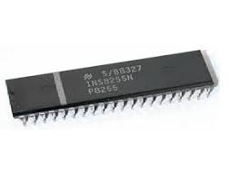
Features of 8255
It is a general purpose programmable I/O device which is compatible with all INTEL processors and also most other processors.
It provides 24 I/O pins which may be individually programmed in two groups. The two groups of I/O pins are named as Group A and Group B.
It is available in 40 pin DIP.
8255 is mainly programmed in two modes (a) I/O mode and (b) bit set/reset mode (BSR) mode. The I/O mode is further divided into three modes: Mode 0, Mode 1, and Mode 2.

Slide 8
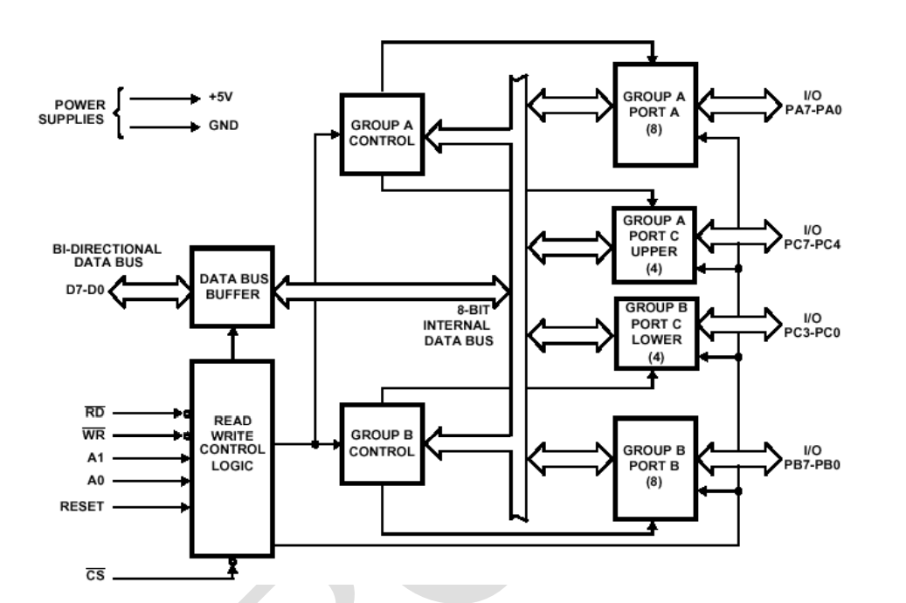
Block Diagram of 8255

Slide 9
Group A Control and Group B Control
Group A control block controls - PortA and PC7-PC4.
Group B controls block controls - Port B and PC3- PC0
Data Bus buffer :
8 bit, 3-state bidirectional used to interface the internal data bus of 8255 to the external system data bus.
Output data from the MPU to the ports or control register and the input data to the MPU from the ports or status register are all pushed through the buffer.
It is controlled by the read/write control logic.
Control Logic
Manage all internal and external transfer of data and control words.
RD’, WR’, A1, A0 and RESET are inputs provided by MPU
It issues commands to the individual group control blocks (Group A Control and Group B Control)

Slide 10
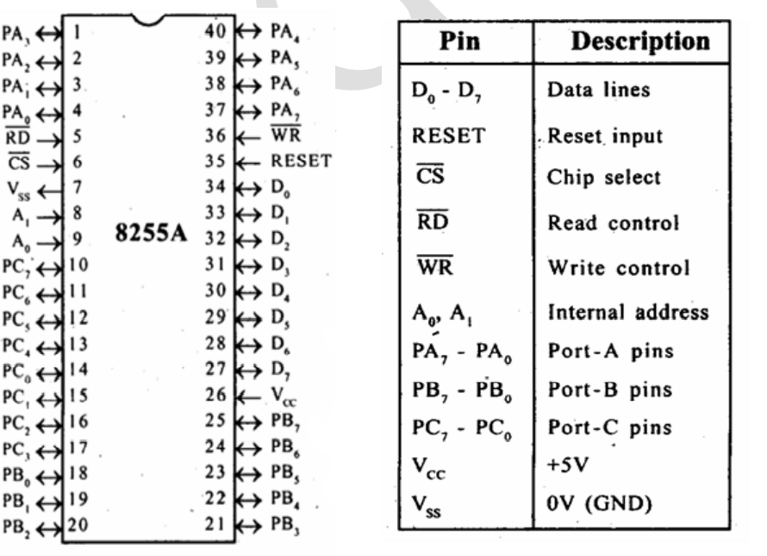
PIN Configuration of 8255

Slide 11
PIN Description
D0-D7 (Data Bus):
Bidirectional data bus lines connected to the system data bus and used to transfer data/control word to/from the microprocessor.
PA0-PA7(PortA): These 8-bit bidirectional I/O pins act as either input or output lines depending upon control word loaded into control word register.
PB0-PB7(Port B): These 8-bitbidirectional I/Opins which can be used same way like Port A.

Slide 12
CONTD
PC0- PC7(port C):
These 8-bit bidirectional I/O pins are divided into two groups PCL (PC0- PC3) and PCU (PC4- PC7).
PCU also can be used for generation of handshake lines in mode 1 or mode 2
RD’ (Read):
Active low signal indicate reads data in the ports or the status word through data buffer.
WR’ (Write): Active low signal writes data in the ports or the control register through data Buffer

Slide 13
CONTD
CS’ (Chip Select):
It is an active low input signal used to enable 8255 to respond RD’ and WR’ signals.
RESET: It is an active high input used to reset 8255. When reset input is high, the control register is cleared and all the ports are set to the input mode.

Slide 14
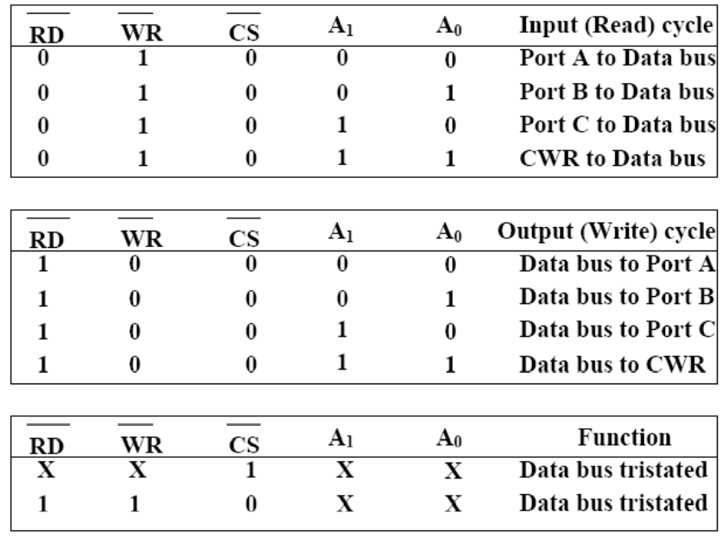
CONTD
A0&A1: These address input signals along with RD’, WR’ inputs control the selection of control / status word registers or one of three ports.

Slide 15
Modes of operation of 8255
Bit Set-Reset Mode (BSR) – used to set or reset its individual port bits.
I/O mode – 8255 ports works as programmable I/O ports
Mode 0: Simple I/O mode
Mode 1 : I/O with Handshaking mode
Mode 2: Bidirectional data transfer mode

Slide 16
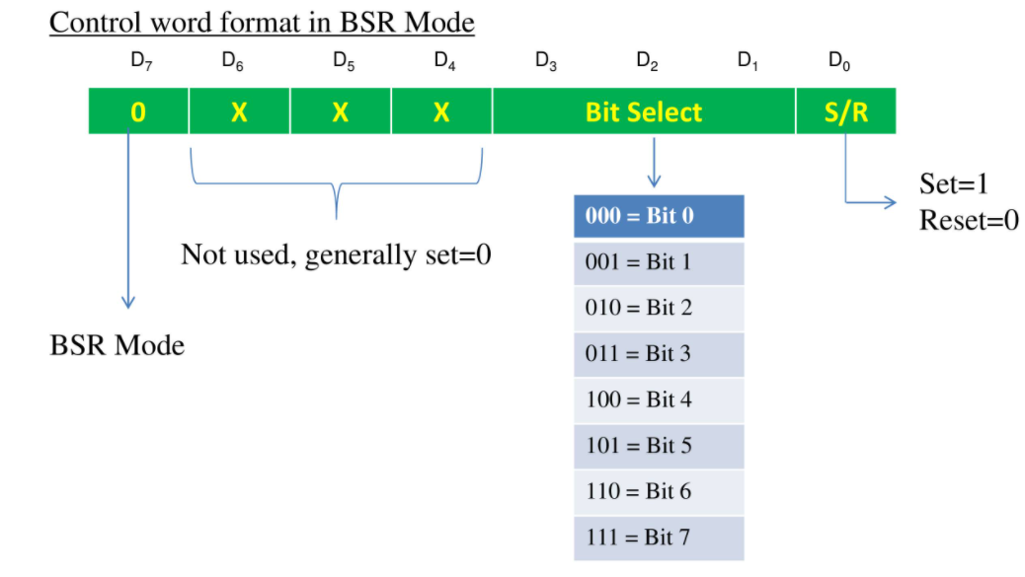
BSR MODE
To know in which mode the interface is working we need to know the value of Control word.
Control word is a part of control register in 8255 which specify an I/O function for each port.
This mode is used to set or reset the bits of the Port-C only.
For BSR mode always D7 will be 0.
The (D3, D2, D1) will be 000 to 111.
In this mode it affects only one bit of Port C at a time.
When user set the bit, it remains set until user unset it.
The user needs to load the bit pattern in control register to change the bit.

Slide 17
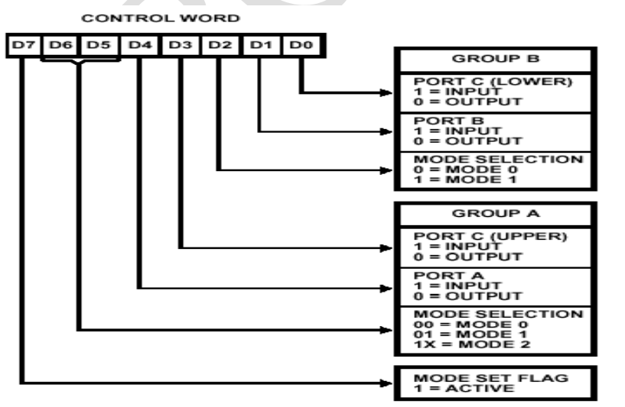
I/O Mode
Mode 0 : Basic Input/output
provides simple input and output operations for each of the three ports.
There are two 8-bitports (A and B) and two 4-bit ports [C (lower)] and [C (upper)].
Any port can be an input port or an output port.
Features:
Outputs are latched and Inputs are not latched.
Ports do not have handshake or interrupt capability

Slide 18
Mode 1: Strobed Input/Output
It provides means for transferring I/O data to or from a specified port in conjunction with strobes or hand-shaking signals.
Port A and port B use the lines on port C for handshaking signals.
Features,
Two ports A and B function as 8 bit I/O ports.
Each port uses three lines from port C as handshake signals and remaining signals used for I/O functions
Input and output data are latched
Interrupt logic is supported

Slide 19
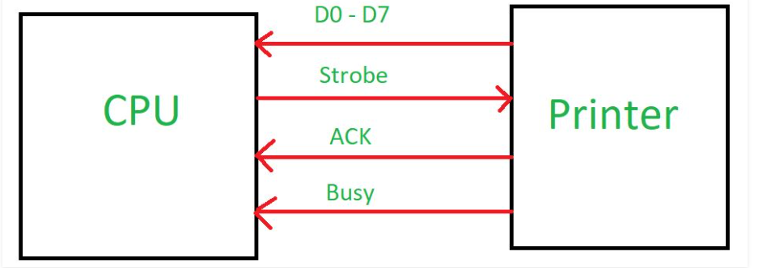
EX: Mode 1
When CPU wants to send data to slow peripheral device like printer, it will send handshaking signal to printer to tell whether it is ready or not to transfer the data.
When printer will be ready, it will send one acknowledgement to CPU then there will be transfer of data through data bus.

Slide 20
Mode 2 : Strobed Bidirectional Bus
In this mode only port A works, and port B can work either in mode 0 or mode 1.
Port A is used as bi-directional port with simultaneous input and output capability.
6 bits of Port C are used as handshake signals.
It also has interrupt handling capacity.

Slide 21
Steps required to communicate with peripherals through 8255
Determine the addresses of Port A, B, C and Control register according to Chip Select Logic and the Address lines A0 and A1.
Write a control word in control register.
Write I/O instructions to communicate with peripherals through port A, B, C.

Slide 22
THANK YOU

